Slide 1
Reactive
Programming
Basic

Slide 2
Introduction to reactive programming

Slide 3
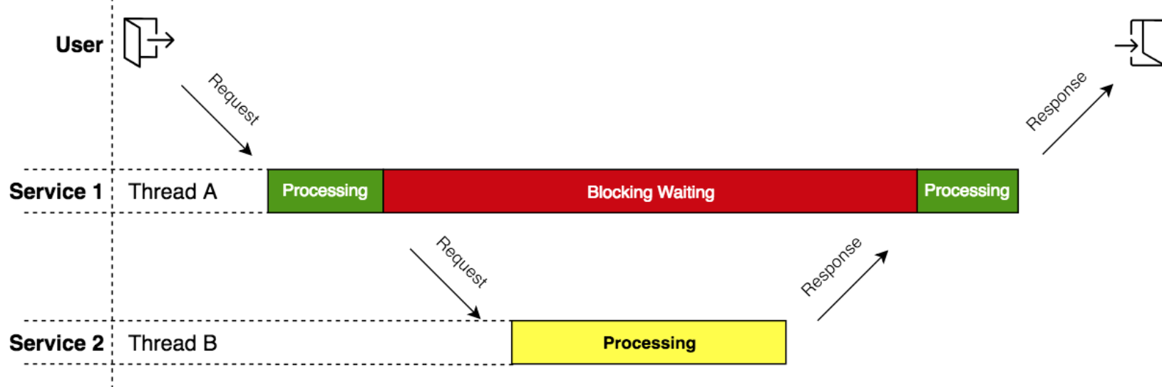
Traditional Approach
Imperative / Top down style
Synchronous & Blocking
No Back Pressure support
Application
getUserProfile(identity)
userProfile
Third Party
Userprofile-API
Local
Database
getUserACL(identity)
acls
application can overwhelmed by data sent by db

Slide 4
Reactive Programming
Declarative programming style
Asynchronous & non blocking
Data flow as event driven stream
Support Back pressure on data stream
Subscriber
Data stream
Publisher
subscription
Publisher / Observable
Observer / Subscriber
Subscription
Processor / Operators

Slide 5
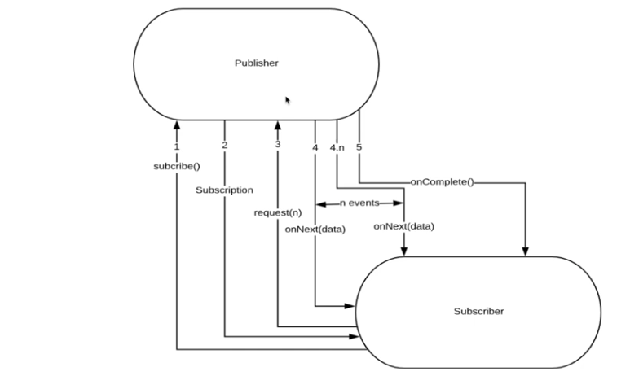
Reactive Stream Specification
Standardization of Reactive Streams. Some of the implementations are Project Reactor, RxJava2, Akka
Hot/Cold
public interface Publisher<T> {
public void subscribe(Subscriber<? super T> s);
}
public interface Subscriber<T> {
public void onSubscribe(Subscription s);
public void onNext(T t);
public void onError(Throwable t);
public void onComplete();
}
public interface Subscription {
public void request(long n);
public void cancel();
}
public interface Processor<T, R> extends Subscriber<T>, Publisher<R> {
}
https://github.com/reactive-streams/reactive-streams-jvm
Notes:
Rules for reactive stream to follow
Created By NetFlix, Pivotal etc
OnNext: Whenever the Observable emits an event, this method is called on our Observer, which takes as parameter the object emitted so we can perform some action on it.
OnCompleted: This method is called after the last call of the onNext method, indicating that the sequence of events associated with an Observable is complete and it has not encountered any errors.
OnError: This method is called when it has encountered some error to generate the expected data, like an unhandled exception.
Hot Publisher Image a Movie theater / Radio station. It doesn't matter if people are really listening to the radio. They will be always streaming songs/news. Listeners can observe anytime they want. But all listeners get they same info at any given moment. They get the news/songs whatever broadcast in that moment. Observers lose the information if they joined late. Hot Publishers are like this Radio Station.
Cold Publisher,Publishers by default do not produce any value unless at least 1 observer subscribes to it. Publishers create new data producers for each new subscription.

Slide 6
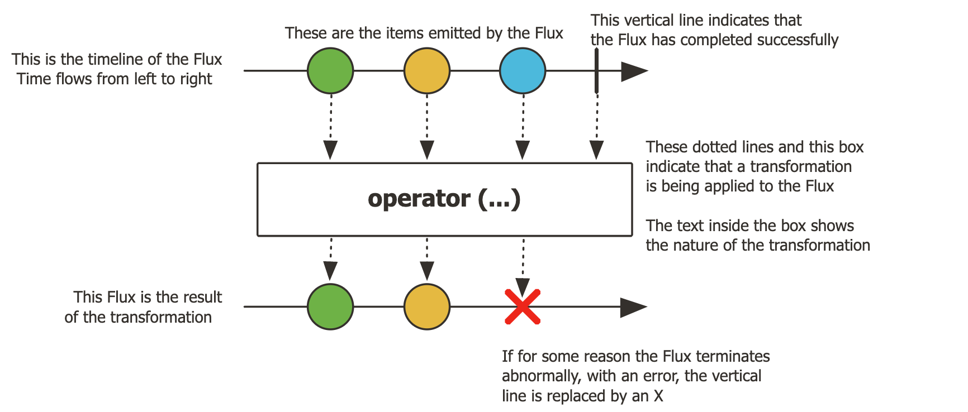
Reactive Publisher
Flux is a Publisher that emits 0 to N elements, and then completes (successfully or with an error)
onNext x 0..N [onError | onComplete]

Slide 7
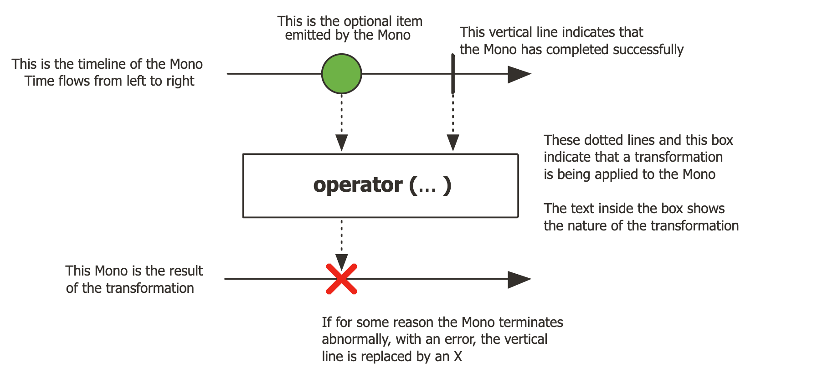
Reactive Publisher
Mono is a Publisher that hat completes successfully by emitting an element, or with an error.
onNext x 0..1 [onError | onComplete]

Slide 8
Reactive Types Of RxJava2
Observable not compatible with the Reactive Streams specification. does not support backpressure and does not implement the Publisher
Flowable counterpart of Reactor's Flux type implements Reactive Streams' Publisher
Single type represents streams that produce precisely one element. semantics of CompletableFuture than Reactor's Mono type
Maybe semantics as Reactor's Mono type Reactive Streams compliant, as Maybe does not implement the Publisher interface
Notes:
Rules for reactive stream to follow
Created By NetFlix, Pivotal etc

Slide 9
Operators: Creating Sequence
empty | Create a publisher that completes without emitting any item.
just | Create N publishers that emits the provided elements and then completes.
fromIterable | Create a Flux that emits the items contained in the provided Iterable.
range | Emit a sequence of count incrementing integers, starting from start.
interval | Emits long values starting with 0 and incrementing at specified time intervals on the global timer.
fromArray | Create a Flux that emits the items contained in the provided array.
fromStream | Create a Flux that emits the items contained in the provided Stream.
create | Programmatically create a Flux with the capability of emitting multiple elements in a synchronous or asynchronous manner through the FluxSink API. This includes emitting elements from multiple threads.
generate | Programmatically create a Flux by generating signals one-by-one via a consumer callback. generate method is aware of downstream observers processing speed

Slide 10
Operators: Transform & Combine Publishers
filter | Evaluate each source value against the given Predicate. If the predicate test succeeds, the value is emitted. If the predicate test fails, the value is ignored
map | Transform the items emitted by this Flux by applying a synchronous function to each item
flatMap | Transform the elements emitted by this Flux asynchronously into Publishers, then flatten these inner publishers into a single Flux through merging, which allow them to interleave.
concatMap | Same as flatMap but merge emitted elements in the order of their source element
switchMap | SwitchMap flattens the source observable but only returns the last emitted single observable.
merge | Combine observables does not maintain order.
concat | Combine observables with order.
zip | Combine these elements once into a Tuple2.
zipWith | Combine these elements once into a Tuple2.

Slide 11
Operators: Batching
buffer | Collect incoming values into multiple List buffers that will be emitted by the returned Flux each time the given max size is reached or once this Flux completes
windowUntil | Split this Flux sequence into multiple Flux windows delimited by the given predicate. A new window is opened each time the predicate returns true..
window | Split this Flux sequence into multiple Flux windows containing maxSize elements (or less for the final window) and starting from the first item. Each Flux window will onComplete after maxSize items have been routed.
groupby | Divide this sequence into dynamically created Flux (or groups) for each unique key, as produced by the provided keyMapper Function. Note that groupBy works best with a low cardinality of groups, so chose your keyMapper function accordingly.

Slide 12
Operators: Control flow
take | Create a publishers that emits the provided elements and then completes.
limitRequest | stricter form of take(long)
onErrorReturn | Simply emit a captured fallback value when any error is observed
onErrorResume | Subscribe to a returned fallback publisher when any error occurs
doOnError | Add behavior (side-effect) triggered when the Flux completes with an error
doFinally | Add behavior (side-effect) triggered after the Flux terminates for any reason, including cancellation.

Slide 13
Operators: Subscription
subscribe | Subscribe to this Flux with a Consumer that will consume all the elements in the sequence, as well as a Consumer that will handle errors.
repeat | operator subscribes to the results of the stream operator, receives elements 1 to N and the onComplete signal

Slide 14
Hot vs Cold Publisher
Cold Publisher:
Publishers by default do not produce any value unless at least 1 observer subscribes to it. Publishers create new data producers for each new subscription.
Hot Publisher:
Hot Publishers do not create new data producer for each new subscription (as the Cold Publisher does). Instead there will be only one data producer and all the observers listen to the data produced by the single data producer. So all the observers get the same data.
These publishers keep emitting data, and, when a new subscriber arrives, it receives only newly emitted data.

Slide 15
Schedulers
Usually, Reactive applications run on the main thread but there are cases where we need to use multi thread. For example, after receiving an item from the Publisher, the Consumer needs to process something different from that data item. That manipulation, we can run on another thread to increase performance. In Project Reactor, to use multi thread we can use the Scheduler object.
The 4 schedulers offered by Reactor are :
single: a one worker thread scheduler
immediate: a scheduler that computes the stream in the thread where the call to the method configuring it is done.
parallel: a scheduler that has as many workers as your CPU has cores.
elastic: a scheduler that dynamically creates threads when needed, with no up limit. A thread is released after 60 non-working seconds.
Configure the scheduler using:
subscribeOn: Sets the scheduler for all the operations of the stream. If multiple subscribeOn operators in a chain first one picked.
publishOn: it affects the subsequent operators until another publishOn is chained in.
publishOn forces the next operator (and possibly subsequent operators after the next one) to run on a different thread. Similarly, subscribeOn forces the previous operator (and possibly operators prior to the previous one) to run on a different thread.
ParallelFlux: Flux runs sequentially by default. To make a Flux parallel, there exists a .parallel() pecify the scheduler via runOn

Slide 16
Operators: Backpressure
When it comes to streaming data, streams can be overly chatty in which the consumer cannot keep up with the producer. Back pressure mechanisms to control the source so that the consumer does not get overwhelmed.
Hot and Cold – that are totally different when it comes to a back pressure handling.
Cold Observable emits a particular sequence of items, but can begin emitting this sequence when its Observer finds it to be convenient, and at whatever rate the Observer desires, without disrupting the integrity of the sequence. Examples of cold Observables include, reading a File, database queries, web requests
Hot Observables are continuous streams of events, emitted regardless of the number of subscribers. When an Observer subscribes to a hot Observable, it can either in the middle of the sequence, beginning of the first item emitted. Examples of hot Observables include, touch events, notifications, and progress updates.
Control the producer decided by consumer
Buffer accumulate incoming data spikes temporarily
Drop (sample a percentage of the incoming data)
https://github.com/reactive-streams/reactive-streams-jvm

Slide 17
Operators: backpressure
sample
delayUntil
onBackpressureDrop
onBackpressureBuffer
onBackpressureError
bufferTimeOut

Slide 18
Spring WebFlux

Slide 19
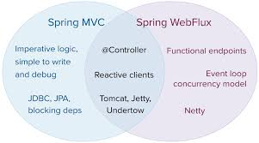
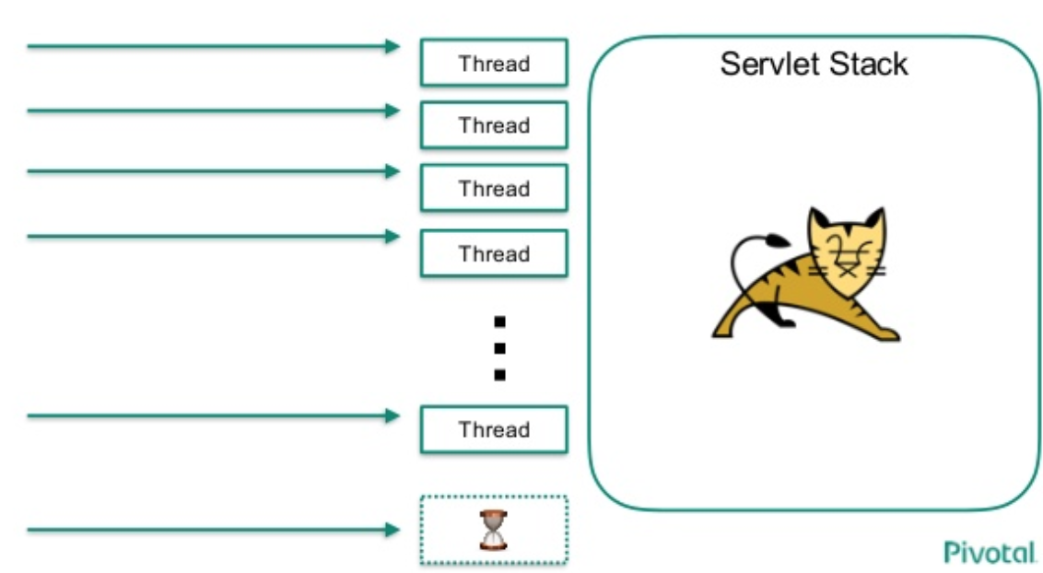
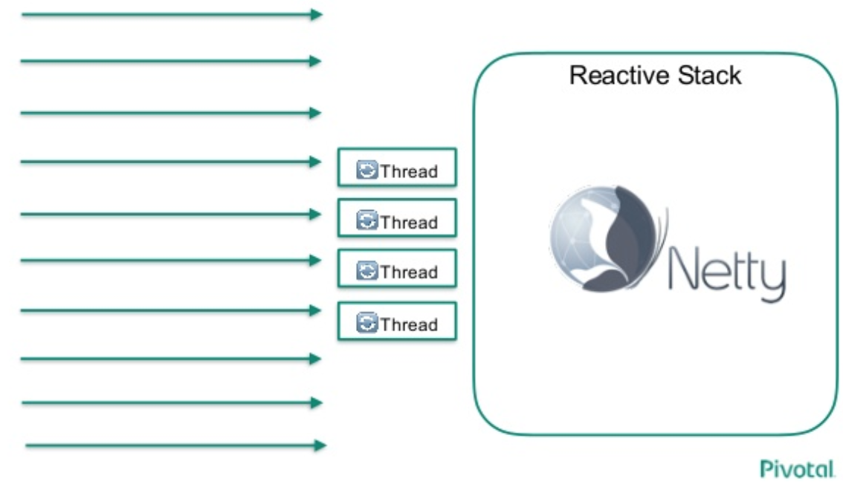
Blocking Vs Non Blocking

Slide 20
Task
Use Case: publisher publish some events to related to purchases. consumer group is interested in listening to those events.
Sample application

